Slide 1


Welcome every one……..
This workshop is tailored for practical, hands on learning to ensure you’re ready to handle email automation related challenges in professional settings

Slide 2

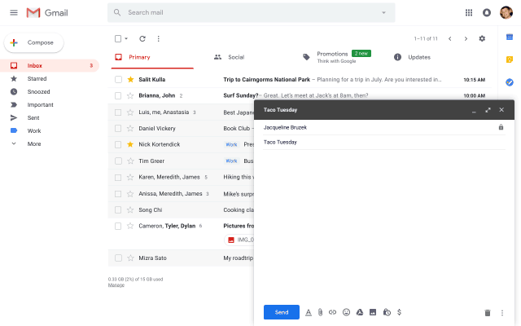


SOFTWARES REQUIRED:
1).Xampp server
2).Mail composer
3).code editor
X-CROSS PLATFORM
A-APACHE
M-MySQL
P-PHP
P-PEARL

Slide 3



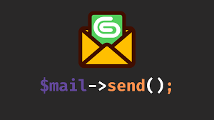
Installation of necessary packages:

Slide 4
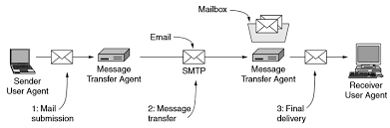
Mail System Architecture:

Slide 5


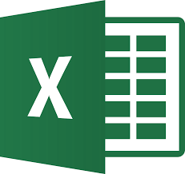
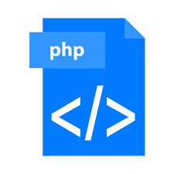
Mail System Architecture:

Slide 6

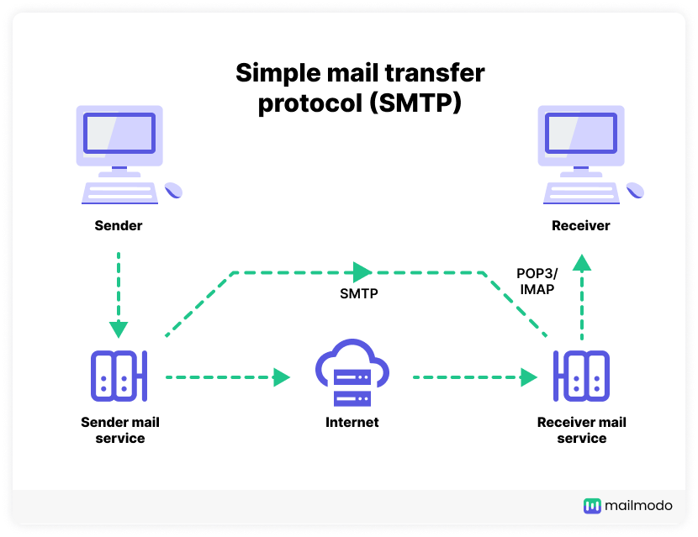

Slide 7
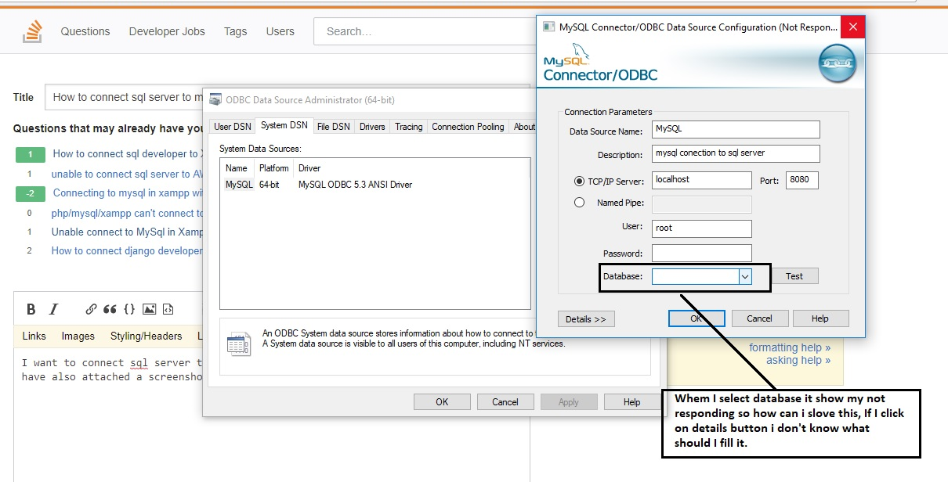
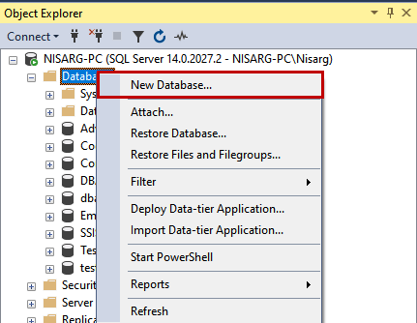
Connecting to DATABASE:

Slide 8
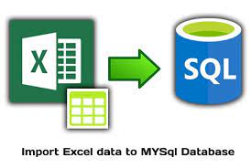
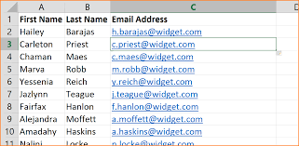
Importing Data To Data Base:

Slide 9

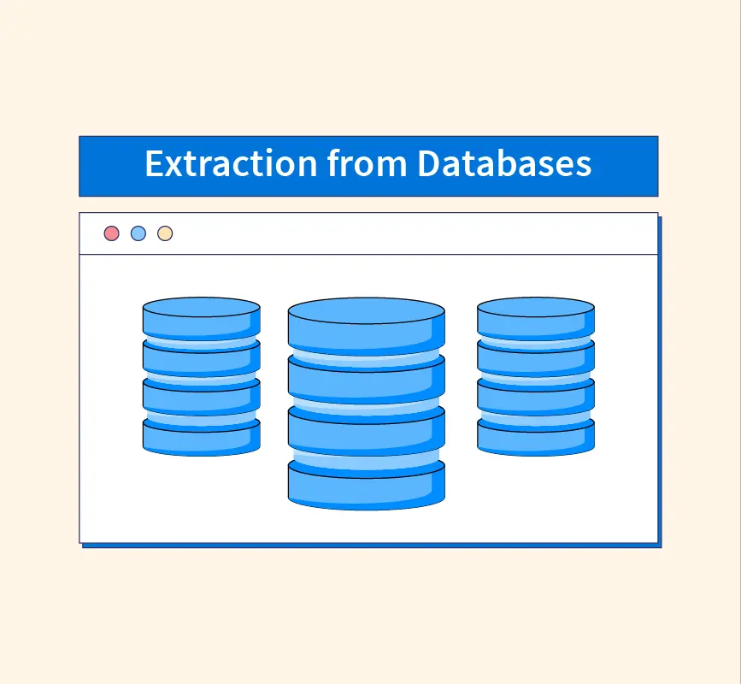
Retrieving Data from database:
Step-1:
Extract all the mail info from database
Step-2:
Automation of mails

Slide 10

TASK for you :

Slide 11

Challenges faced while doing mail automation:

Slide 12

THANK YOU…..

